Slide 1
Laboratory diagnostics of veterinary important agents from genera Bacillus and Urease test

Slide 2
General Characteristics of Bacillus
Generally motile with peritrichous flagella except B. anthracis (non-motile)
Gram positive bacilli when young, but in some species become Gram negative as they age.
Produce endospores: non-bulging, central oval spores. endospores of living bacilli appear edged in black and are very bright and refractile. • Endospores strongly resist application of simple stains or dyes and hence appear as non-staining entities in Gram-stain preparations.
Ends of bacilli are truncated or concave giving a Bamboo – stick appearance – (end to end arranged long chains of bacilli)

Slide 3
Peritrichous bacteria have flagella projecting in all directions
Endospores

Slide 4
Culture Characteristics of Bacillus
Colonies on blood agar are nonhemolytic, flat or slightly convex with irregular edges and ground-glass appearance. There are often comma shaped projections from the colony edge producing a “Medusa-head” colony.
Bacillus are Gelatinase-positive : giving inverted fir tree appearance due to slow liquefaction of gelatin.
Aerobic or facultative anaerobic
Can flourish at extremes of acidity & alkalinity (pH 2 to 10)

Slide 5
Colonies on blood agar are nonhemolytic
fir tree appearance

Slide 6
Diagnosis
Swab from cutaneous lesion, Sputum, Fluid, pus.
Gram Stained smears from the local lesion or of blood from dead animals often show chains of large gram-positive rods.
Spores seen after several days of incubation, but not typically in fresh clinical specimens

Slide 7
Diseases Associated with Bacillus
Most are Ubiquitous in nature, Bacillus includes both free-living (nonparasitic) species, and two parasitic pathogenic species. These two Bacillus species are medically significant: B.anthracis causes anthrax; and B. cereus causes food poisoning.
Bacillus anthracis is most important member. Primarily a disease of herbivorous animals. Most commonly transmitted to humans (Accidental host) by direct contact with animal products (e.g., wool and hair) Also acquired via inhalation & ingestion
B. cereus Infections: Cause food poisoning. infection include emetic (vomiting) and diarrheal forms of gastroenteritis.

Slide 8
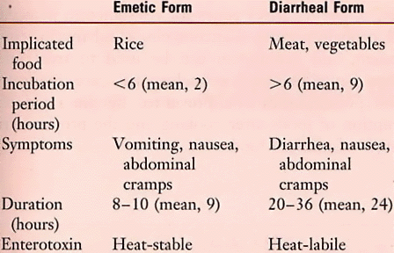

Slide 9
Clinical Presentation of Anthrax
Cutaneous Anthrax: 95% human cases are cutaneous infections. Small, pruritic, non-painful papule at inoculation site. Papule develops into hemorrhagic vesicle & ruptures. Slow-healing painless ulcer covered with black eschar surrounded by edema.
Inhalation Anthrax: is the most deadly form, Virtually 100% fatal (pneumonic)
Gastrointestinal (Ingestion) Anthrax: is a rare but commonly fatal disease.

Slide 11
Epidemiology of Anthrax in Animal and Human Hosts

Slide 12
Treatment & Prophylaxis
Treatment
Penicillin is drug of choice
Doxycycline now commonly recognized as prophylactic

Slide 13
Urease test
Principle of Urease Test
This test is used to differentiate organisms based on their ability to hydrolyze urea through the production of the enzyme urease. Hydrolysis of urea produces ammonia and CO2.
Media used in Urease Test
Christensen’s Urea Agar
Procedure of Urease test:
Streak the surface of a Urea agar slant with a portion of a well-isolated colony by touching the tip of a needle to a colony that is 18 to 24 hours old.
Leave the cap on loosely and incubate the tube at 35°-37°C in ambient air for 48 hours to 7 days.
Observe the development of color.
+ results: Pink color - results: Yellow color

Slide 14
Examples of Urease positive bacteria: Proteus spp, Cryptococcus spp, Corynebacterium spp, Helicobacter pylori,Yersinia spp, Brucella spp, etc. Examples of Urease negative bacteria: : Escherichia, Shigella, Salmonella, etc.

